Slide 2
File System
a. Files
b. Directories
c. File system implementation
d. Protection mechanism and operating system securities

Slide 3
File
File system is the part of the operating system which is responsible for file management. It provides a mechanism to store the data and access to the file contents including data and programs. Some Operating systems treats everything as a file for example Ubuntu.
The File system takes care of the following issues

Slide 4
File Structure
We have seen various data structures in which the file can be stored. The task of the file system is to maintain an optimal file structure.
Recovering Free space
Whenever a file gets deleted from the hard disk, there is a free space created in the disk. There can be many such spaces which need to be recovered in order to reallocate them to other files.
Disk space assignment to the files:
The major concern about the file is deciding where to store the files on the hard disk. There are various disks scheduling algorithm which will be covered later in this tutorial.
Tracking data location:
A File may or may not be stored within only one block. It can be stored in the non contiguous blocks on the disk. We need to keep track of all the blocks on which the part of the files reside

Slide 5
A computer file is defined as a medium used for saving and managing data in the computer system. The data stored in the computer system is completely in digital format, although there can be various types of files that help us to store the data.
What is a File System?
A file system is a method an operating system uses to store, organize, and manage files and directories on a storage device. Some common types of file systems include:
FAT (File Allocation Table): An older file system used by older versions of Windows and other operating systems.
NTFS (New Technology File System): A modern file system used by Windows. It supports features such as file and folder permissions, compression, and encryption.
ext (Extended File System): A file system commonly used on Linux and Unix-based operating systems.

Slide 6
HFS (Hierarchical File System): A file system used by macOS.
APFS (Apple File System): A new file system introduced by Apple for their Macs and iOS devices.
A file is a collection of related information that is recorded on secondary storage. Or file is a collection of logically related entities. From the user’s perspective, a file is the smallest allotment of logical secondary storage.
The name of the file is divided into two parts as shown below:
name
extension, separated by a period.

Slide 7
Issues Handled By File System:
We’ve seen a variety of data structures where the file could be kept. The file system’s job is to keep the files organized in the best way possible.
A free space is created on the hard drive whenever a file is deleted from it. To reallocate them to other files, many of these spaces may need to be recovered.
Choosing where to store the files on the hard disc is the main issue with files one block may or may not be used to store a file. It may be kept in the disk’s non-contiguous blocks. We must keep track of all the blocks where the files are partially located.

Slide 8
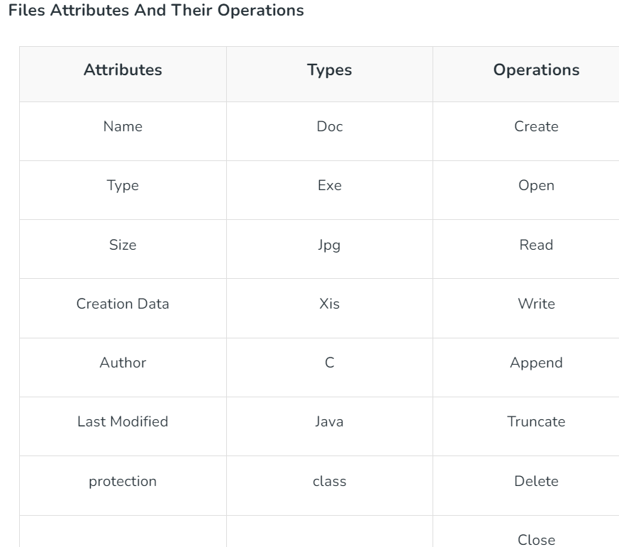

Slide 9
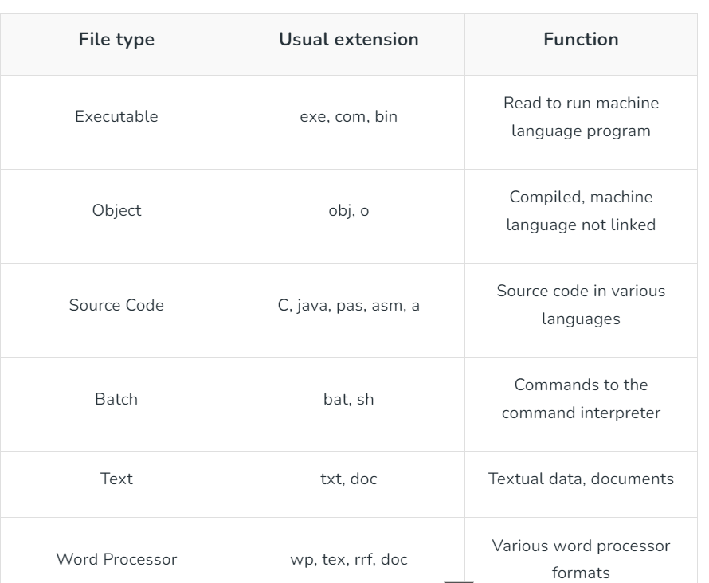

Slide 10
File Directories
The collection of files is a file directory. The directory contains information about the files, including attributes, location, and ownership. Much of this information, especially that is concerned with storage, is managed by the operating system. The directory is itself a file, accessible by various file management routines.
Below are information contained in a device directory.
Name
Type
Address
Current length
Maximum length
Date last accessed
Date last updated
Owner id
Protection information

Slide 11
The operation performed on the directory are:
Search for a file
Create a file
Delete a file
List a directory
Rename a file
Traverse the file system

Slide 12
Advantages of Maintaining Directories
Efficiency: A file can be located more quickly.
Naming: It becomes convenient for users as two users can have same name for different files or may have different name for same file.
Grouping: Logical grouping of files can be done by properties e.g. all java programs, all games etc.
Single-Level Directory
In this, a single directory is maintained for all the users.
Naming problem: Users cannot have the same name for two files.
Grouping problem: Users cannot group files according to their needs.

Slide 13
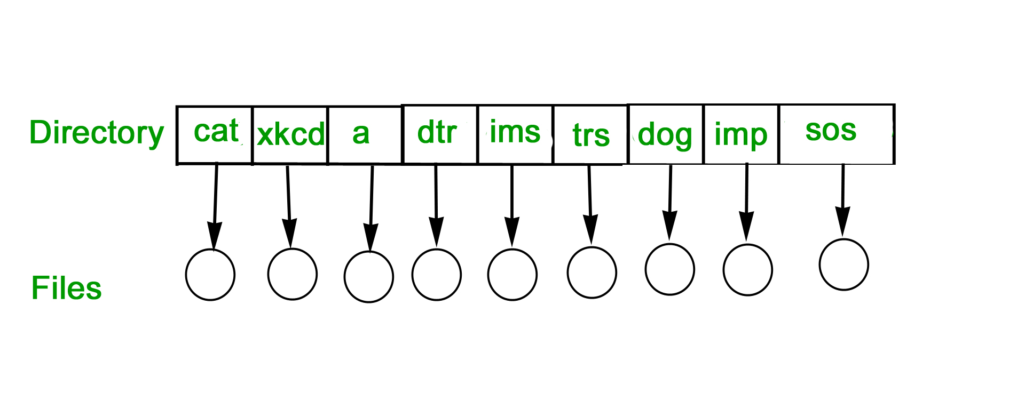

Slide 14
Two-Level Directory:
In this separate directories for each user is maintained.
Path name: Due to two levels there is a path name for every file to locate that file.
Now, we can have the same file name for different users.
Searching is efficient in this method.

Slide 15
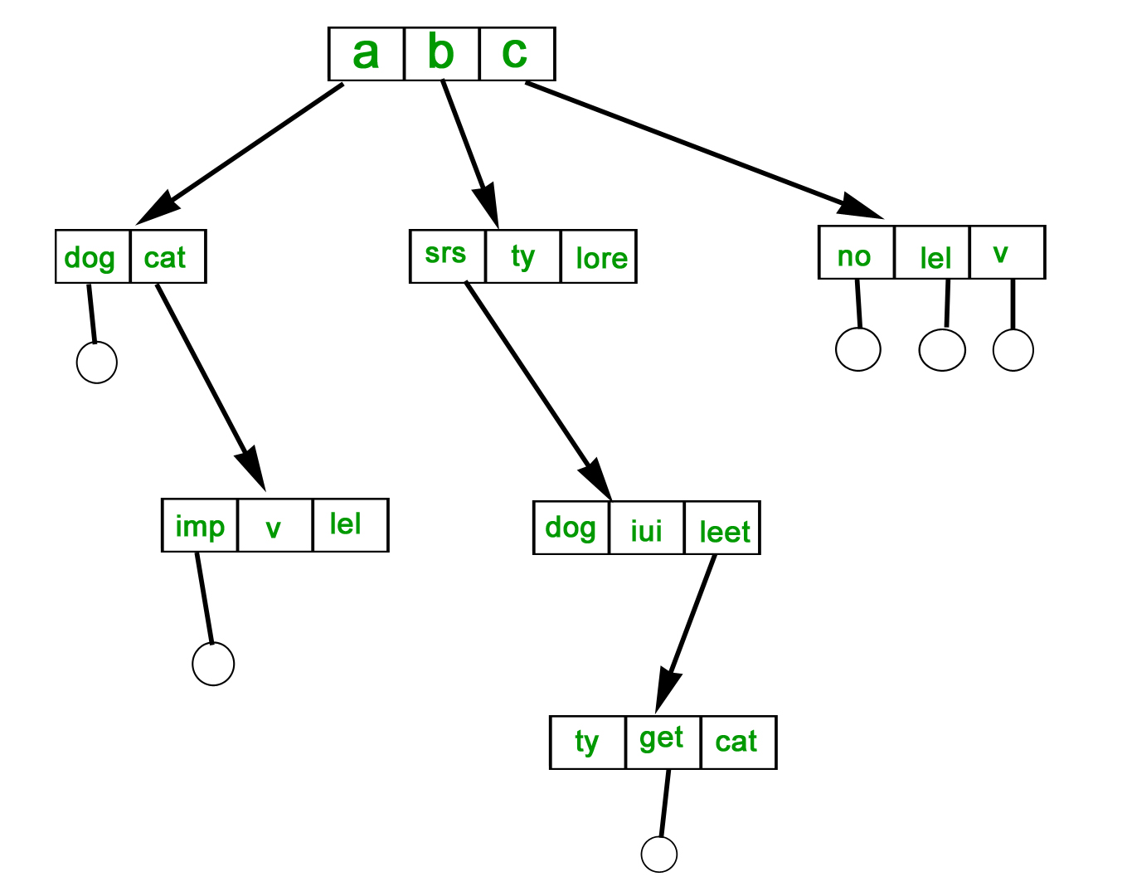
Tree-Structured Directory:
The directory is maintained in the form of a tree. Searching is efficient and also there is grouping capability. We have absolute or relative path name for a file.

Slide 16
File System Implementation in Operating System
A file is a collection of related information. The file system resides on secondary storage and provides efficient and convenient access to the disk by allowing data to be stored, located, and retrieved.
File system implementation in an operating system refers to how the file system manages the storage and retrieval of data on a physical storage device such as a hard drive, solid-state drive, or flash drive. The file system implementation includes several components, including:

Slide 17
File System Structure: The file system structure refers to how the files and directories are organized and stored on the physical storage device. This includes the layout of file systems data structures such as the directory structure, file allocation table, and inodes.
File Allocation: The file allocation mechanism determines how files are allocated on the storage device. This can include allocation techniques such as contiguous allocation, linked allocation, indexed allocation, or a combination of these techniques.
Data Retrieval: The file system implementation determines how the data is read from and written to the physical storage device. This includes strategies such as buffering and caching to optimize file I/O performance.
Security and Permissions: The file system implementation includes features for managing file security and permissions. This includes access control lists (ACLs), file permissions, and ownership management.
Recovery and Fault Tolerance: The file system implementation includes features for recovering from system failures and maintaining data integrity. This includes techniques such as journaling and file system snapshots.

Slide 18
File system implementation is a critical aspect of an operating system as it directly impacts the performance, reliability, and security of the system.
Different operating systems use different file system implementations based on the specific needs of the system and the intended use cases. Some common file systems used in operating systems include NTFS and FAT in Windows, and ext4 and XFS in Linux.

Slide 19
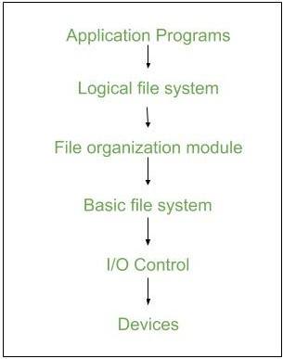

Slide 20
I/O Control level – Device drivers act as an interface between devices and OS, they help to transfer data between disk and main memory. It takes block number as input and as output, it gives low-level hardware-specific instruction.
Basic file system – It Issues general commands to the device driver to read and write physical blocks on disk. It manages the memory buffers and caches. A block in the buffer can hold the contents of the disk block and the cache stores frequently used file system metadata.
File organization Module – It has information about files, the location of files and their logical and physical blocks. Physical blocks do not match with logical numbers of logical blocks numbered from 0 to N. It also has a free space that tracks unallocated blocks.
Logical file system – It manages metadata information about a file i.e. includes all details about a file except the actual contents of the file. It also maintains via file control blocks. File control block (FCB) has information about a file – owner, size, permissions, and location of file contents.

Slide 21
Advantages
Duplication of code is minimized.
Each file system can have its own logical file system.
File system implementation in an operating system provides several advantages, including:
Efficient Data Storage: File system implementation ensures efficient data storage on a physical storage device. It provides a structured way of organizing files and directories, which makes it easy to find and access files.
Data Security: File system implementation includes features for managing file security and permissions. This ensures that sensitive data is protected from unauthorized access.
Data Recovery: The file system implementation includes features for recovering from system failures and maintaining data integrity. This helps to prevent data loss and ensures that data can be recovered in the event of a system failure.

Slide 22
Improved Performance: File system implementation includes techniques such as buffering and caching to optimize file I/O performance. This results in faster access to data and improved overall system performance.
Scalability: File system implementation can be designed to be scalable, making it possible to store and retrieve large amounts of data efficiently.
Flexibility: Different file system implementations can be designed to meet specific needs and use cases. This allows developers to choose the best file system implementation for their specific requirements.
Cross-Platform Compatibility: Many file system implementations are cross-platform compatible, which means they can be used on different operating systems. This makes it easy to transfer files between different systems.

Slide 23
Disadvantages
If we access many files at the same time then it results in low performance. We can implement a file system by using two types of data structures :
Boot Control Block – It is usually the first block of volume and it contains information needed to boot an operating system. In UNIX it is called the boot block and in NTFS it is called the partition boot sector.
Volume Control Block – It has information about a particular partition ex:- free block count, block size and block pointers, etc. In UNIX it is called superblock and in NTFS it is stored in the master file table.
Directory Structure – They store file names and associated inode numbers. In UNIX, includes file names and associated file names and in NTFS, it is stored in the master file table.
Per-File FCB – It contains details about files and it has a unique identifier number to allow association with the directory entry. In NTFS it is stored in the master file table.
Mount Table – It contains information about each mounted volume.
Directory-Structure cache – This cache holds the directory information of recently accessed directories.
System-wide open-file table – It contains the copy of the FCB of each open file.
Per-process open-file table – It contains information opened by that particular process and it maps with the appropriate system-wide open-file.

Slide 24
Linear List – It maintains a linear list of filenames with pointers to the data blocks. It is time-consuming also. To create a new file, we must first search the directory to be sure that no existing file has the same name then we add a file at the end of the directory. To delete a file, we search the directory for the named file and release the space. To reuse the directory entry either we can mark the entry as unused or we can attach it to a list of free directories.
Hash Table – The hash table takes a value computed from the file name and returns a pointer to the file. It decreases the directory search time. The insertion and deletion process of files is easy. The major difficulty is hash tables are its generally fixed size and hash tables are dependent on the hash function of that size.

Slide 25
Implementation Issues
Management of disc space: To prevent space wastage and to guarantee that files can always be stored in contiguous blocks, file systems must manage disc space effectively. Free space management, fragmentation prevention, and garbage collection are methods for managing disc space.
Checking for consistency and repairing errors: The consistency and error-free operation of files and directories must be guaranteed by file systems. Journaling, checksumming, and redundancy are methods for consistency checking and error recovery. File systems may need to perform recovery operations if errors happen in order to restore lost or damaged data.

Slide 26
Locking files and managing concurrency: To prevent conflicts and guarantee data integrity, file systems must control how many processes or users can access a file at once. File locking, semaphore, and other concurrency-controlling methods are available.
Performance optimization: File systems need to optimize performance by reducing file access times, increasing throughput, and minimizing system overhead. Caching, buffering, prefetching, and parallel processing are methods for improving performance.

Slide 27
Key Steps Involved In File System Implementation
Partitioning the storage device: The first step in file system implementation is to partition the physical storage device into one or more logical partitions. Each partition is formatted with a specific file system that defines the way files and directories are organized and stored.
File system structures: File system structures are the data structures used by the operating system to manage files and directories. Some of the key file system structures include the superblock, inode table, directory structure, and file allocation table.
Allocation of storage space: The file system must allocate storage space for each file and directory on the storage device. There are several methods for allocating storage space, including contiguous, linked, and indexed allocation.

Slide 28
File operations: The file system provides a set of operations that can be performed on files and directories, including create, delete, read, write, open, close, and seek. These operations are implemented using the file system structures and the storage allocation methods.
File system security: The file system must provide security mechanisms to protect files and directories from unauthorized access or modification. This can be done by setting file permissions, access control lists, or encryption.
File system maintenance: The file system must be maintained to ensure efficient and reliable operation. This includes tasks such as disk defragmentation, disk checking, and backup and recovery.

Slide 29
What are the key components of a file system?
A file system typically consists of the following key components:
Disk space allocation: Determines how disk space is allocated to files and directories.
Directory structure: Defines the organization of files and directories in a hierarchical structure.
File metadata: Stores information about files, such as file name, size, creation/modification timestamps, permissions, and ownership.
File operations: Provides functions to create, read, write, delete, and modify files.
File access control: Manages permissions and access rights to files and directories to ensure security and privacy.
File system utilities: Includes tools for formatting, checking, and repairing file systems.

Slide 30
What are the different types of file systems?
FAT32 (File Allocation Table 32): Commonly used in older versions of Windows and compatible with various operating systems.
NTFS (New Technology File System): Used in modern Windows operating systems, offering improved performance, reliability, and security features.
ext4 (Fourth Extended File System): Used in Linux distributions, providing features such as journaling, large file support, and extended file attributes.
HFS+ (Hierarchical File System Plus): Used in macOS systems prior to macOS High Sierra, offering support for journaling and case-insensitive file names.
APFS (Apple File System): Introduced in macOS High Sierra and the default file system for macOS and iOS devices, featuring enhanced performance, security, and snapshot capabilities.
ZFS (Zettabyte File System): A high-performance file system known for its advanced features, including data integrity, volume management, and efficient snapshots.

